Slide 1
Sleep Disturbance in Patients with Liver Transplants and its Relationship to Quality of Life
BTC 1842H: DATA SCIENCE IN HEALTH I
Team 2 (Praetor): Kevin Schubert, Vivian Pan, Kaiwen Zhang

Slide 2
Abstract
01
The Problem
02
Prevalence
03
Predictors of Sleep
Predictors of QOL
04
Decreased HRQOL post-liver transplantation
Of sleep disturbance
Strongest predictors of sleep disturbance
Effect of sleep disturbance on QOL

Slide 3
The Problem
Liver Diseases / Transplantation
Complications & Morbidities
Sleep Disturbances
Decreased HRQOL
Notes:
HRQOL is known to be lower in liver transplant patients than amongst the general population
Literature has shown that some common complications include immunosuppression, osteoporosis and sleep disturbances
Excessive daytime sleepiness, obstructive sleep apnea, fatigue → physical, mental and social impairments → lower QOL

Slide 4
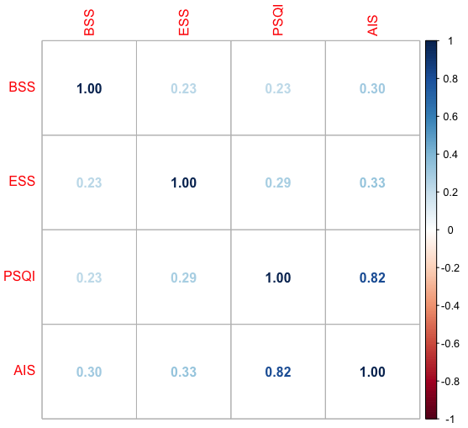
Cleaning the Data
Check: outliers and invalids
Removing NA’s
Check: collinearity
Calculate: prevalence of sleep disturbance
R² = 0.82
1
VIF =
= 5.55
1 - R²
Notes:
Cleaning data
Checked for outliers and invalid data points
Removed invalid values
Kept the rest of them, they affect the regression models
Kept NA’s in dataframe, using na.omit() took out too many entries
Reduced df from 268 → 151 entries
Decided not to remove NA’s from the entire dataframe
To deal with NA’s, new data frames were created with select columns
Checked for collinearity between clinical predictors and sleep scales:
None of the predictors for sleep disturbance had an R² > 0.8 so they were all included
PSQI and AIS had a 0.82 correlation, this yields a VIF of 5.55 which is greater than the threshold
PSQI also had 85 NA values whereas AIS only had 5
85/268 = 32%, according to lecture 11 on missing data, columns should be removed if >30% of values are missing

Slide 5
Prevalence of Sleep Disturbance
100%
Convert scales to binary
Calculate: prevalence of sleep disturbance
of patients experienced some type of sleep disturbance
27%
55%
55%
39%
ESS (EDS)
PSQI (general, long- and short-term)
AIS (general, EDS)
BSS (OSA)

Slide 6
Methods: Machine Learning Pipeline
Sleep Scale Scores
Clinical Data
HRQOL
Cleaned data goes through pipeline
Linear and logistic regression models
Predictors: clinical data
Response: sleep scale scores
Linear regression models
Predictors: sleep scale scores
Response: SF-36 scores
Notes:
Models selected by AIC over anova
Sleep scale scores: stepwise from strongest feature from most complicated model
BSS limited to 6 features, rest 16
Identify the relationship between sleep disturbance and quality of life (physical and mental), HRQOL = health related quality of life
HRQOL: stepwise exclusion from most complicated model

Slide 7
Results - BSS
Features | AIC | Anova
(1) BMI | 274.1265 | -
(2) + Renal Failure | 272.0417 | (1) vs (2), p = 0.04327
(3) + Age | 269.7642 | (2) vs (3), p = 0.05997
(4) + Others | Increases | Favours (3), p > 0.05
Notes:
No significantly correlated predictors; initial model selected based on significance and lowest initial AIC
AIC indicates some sort of better fit for more complex models; already penalizes additional features.
ANOVA findings are different

Slide 8
Results - AIS
Features | AIC | Anova
(1) Corticoid | 1471.812 | -
(2) + Recurrence | 1462.772 | (1) vs (2), p = 0.00097
(3) + Age | 1456.622 | (2) vs (3), p = 0.0047
(4) + BMI | 1455.562 | (3) vs (4), p = 0.08382
(5) + others | Increases | Favours (4), p > 0.05
Notes:
Corticoid p-value = 0.0175, Recurrence p-value = 0.0260, Age p-value = 0.0311
Closely competing models exist either by adding depression (AIC = 1455.898, anova p = 0.1), or replacing BMI with depression (AIC = 1455.945, anova p = 0.1059)

Slide 9
Results - ESS
Features | AIC | Anova
(1) RGD (Graft Rejection) | 1359.122 | -
(2) + Depression | 1357.192 | (1) vs (2), p = 0.04917
(3) + Gender | 1354.957 | (2) vs (3), p = 0.04159
(4) + Others | Increases | Favours (3), p > 0.05
Notes:
No significant correlated predictors, corticoid p-value = 0.06, graft rejection p-value = 0.09
Model selection supported by both AIC and anova findings

Slide 10
Results - MCS
Features | AIC | Anova
(1) AIS, ESS, BSS | 1752.804 | -
(2) AIS, ESS | 1750.987 | (1) vs (2) p = 0.6721
(3) AIS | 1756.541 | (2) vs (3) p = 0.006378
(4) ESS | 1805.883 | (2) vs (4) p = 7.098e-14
Notes:
Relationship: AS sleep disturbance increase MCS PCS decrease
AIC lowest for two feature model
Anova does not favour 3 feature model over 2 feature model
Anova favours 2 feature model over 1 feature models

Slide 11
Results - PCS
Features | AIC | Anova
(1) BSS, AIS, ESS | 1772.192 | -
(2) AIS, BSS | 1778.566 | (1) vs (2) p = 0.004161
(3) ESS, BSS | 1793.657 | (1) vs (3) p = 1.611e-6
(4) AIS, ESS | 1775.888 | (1) vs (4) p = 0.01811

Slide 12
Conclusion
100% Prevalence
of sleep disturbance
Predictors of Sleep
Age was most commonly used
Predictors of QOL
AIS and ESS in both, BSS in PCS
Notes:
BMI, Recurrence, Renal Failure, Age

Slide 13

Thank You
Are there any questions?

